Slide 1











GOODCABS
RESUME PROJECT CHALLENGE-13
Presented by: Shelly Nagar

Slide 2

01
02
03
About Company
Problem Statement
Task
04
05
06
OVERVIEW
Data Analysis Methedology
Dataset
Ad-Hoc Requests
07
08
09
Data Model
Primary & Secondary Analysis
Recommendations
10
Conclusion

Slide 3





01
ABOUT COMPANY
INTRODUCTION
MISSION
OPERATIONS
2024 GOALS
Established two years ago, Goodcabs is a cab service provider with a strong foothold in the Indian market, particularly in tier-2 cities.
Committed to supporting local drivers and providing excellent service to passengers.
Operating in ten tier-2 cities across India, focusing on sustainable livelihoods for local drivers.
Ambitious performance targets to drive growth and enhance passenger satisfaction.

Slide 4


OBJECTIVE
02
Provide actionable insights to the Chief of Operations in the Transportation domain.
METRICS TO ANALYZE
PROBLEM STATEMENT
Trip volume
Passenger satisfaction
Repeat passenger rate
Trip distribution
Balance between new and repeat passengers
CONTEXT
Insights will directly influence strategic decisions and performance evaluation.

Slide 5

03
TASK
01
Conduct a detailed analysis of datasets to derive actionable insights.
02
Design a comprehensive and intuitive dashboard showcasing key metrics and trends.
03
Address specific business questions outlined in ad-hoc-requests.pdf using SQL-based analysis.
04
Prepare a strategic presentation for the Chief of Operations, focusing on insights and recommendations.

Slide 6
Business Problem Understanding: Analyzed business requirements and key objectives.
Exploratory Data Analysis (EDA): Conducted EDA using Power Query and SQL to uncover insights.
04
DATA ANALYSIS METHODOLOGY
Ad-Hoc Analysis: Utilized SQL for answering specific queries and Excel for visualizing results.
Data Cleaning & Transformation: Ensured data integrity and consistency through cleaning, transformation, and established relationships between tables using star and snowflake schemas.
Dashboard Creation: Developed interactive dashboards in Power BI for data visualization.
Results Presentation: Compiled insights and findings into a PowerPoint presentation for stakeholders.

Slide 7
DATASET
05
Primary Databases
trips_db: Contains detailed and aggregated data related to trips, passenger demographics, and repeat trip behavior across tier-2 cities.
targets_db: Holds monthly city-specific performance targets, including trip counts, new passenger acquisition, and average ratings.

Slide 8
trips_db
Table | Detail
dim_city | City-specific data for location-based analysis.
dim_date | Date-specific data for time-based analysis.
fact_passenger_summary | Passenger counts (total, new, repeat) by city and month.
dim_repeat_trip_distribution | Monthly breakdown of repeat trip behavior.
fact_trips | Trip-level data for detailed analysis.

Slide 9
targets_db
Table | Detail
city_target_passenger_rating | Target average passenger rating per city.
monthly_target_new_passengers | Monthly new passenger acquisition targets.
monthly_target_trips | Monthly trip count targets by city.

Slide 10


06
AD-HOC REQUESTS
Craft SQL queries to address the specified business questions.

Slide 11
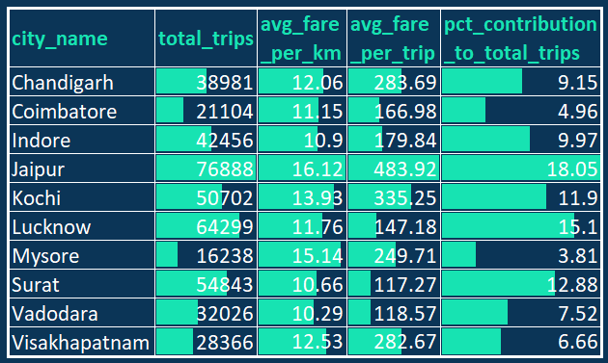
Business Request -1: City-Level Fare and Trip Summary Report
Generate a report that displays the total trips, average fare per km, average fare per trip, and percentage contribution of each city’s trips to the overall trips.

Slide 12
INSIGHTS & RECOMMENDATIONS
INSIGHTS
RECOMMENDATIONS
City Performance
Top Contributors: Jaipur (18.05%) and Lucknow (15.1%) lead in trip contribution.
Underperformers: Mysore (3.81%) and Coimbatore (4.96%) show untapped potential.
Fare Patterns
Highest Average Fare per Trip: Jaipur (₹483.92), indicating premium trips.
Lowest Average Fare per Trip: Surat (₹117.27), reflecting shorter trips or lower pricing.
Demand Drivers
Tourism and events likely boost trip values in cities like Jaipur and Kochi.
Business-centric demand may influence Lucknow’s strong performance.
Boost Repeat Passenger Rates
Launch loyalty programs in underperforming cities (e.g., Mysore, Coimbatore).
Leverage Tourism & Events
Partner with local event organizers in cities like Jaipur and Kochi.
Adopt Emerging Trends
Pilot electric vehicles in eco-conscious cities like Chandigarh and Jaipur.
Enhance Partnerships
Collaborate with local businesses (e.g., hotels, malls) to increase demand.
Improve Data Collection
Capture trip purposes and customer preferences for deeper insights.

Slide 13
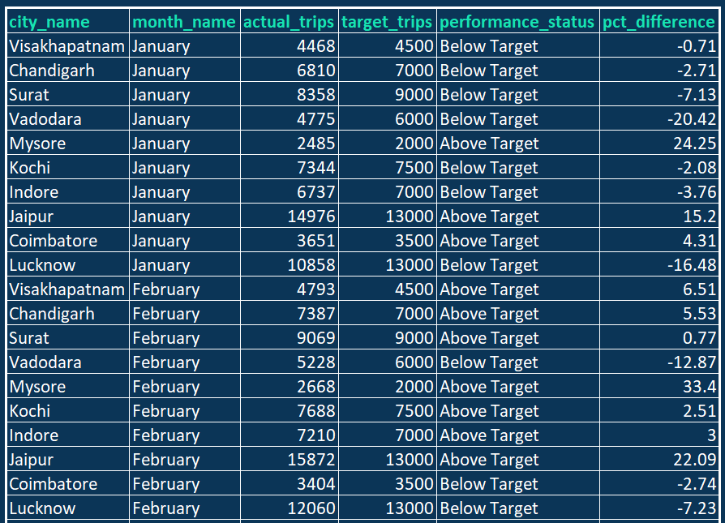
Business Request - 2: Monthly City-Level Trips Target Performance Report
Generate a monthly and city-level report comparing actual and target trips, categorizing performance as "Above Target" or "Below Target," and calculating the percentage difference to quantify the performance gap, with fields: City_name, month_name, actual_trips, target_trips, performance_status, and %_difference.
..more

Slide 14
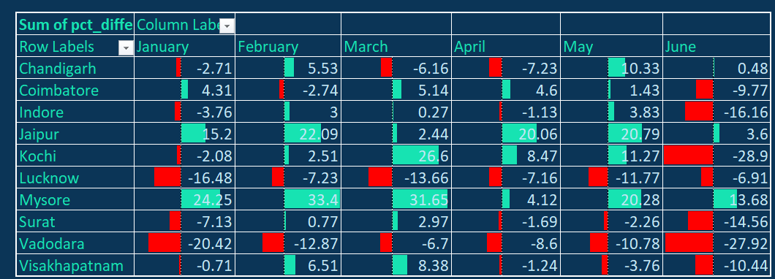
INSIGHTS & RECOMMENDATIONS
INSIGHTS
RECOMMENDATIONS
Top Performers
Jaipur: Consistently exceeds targets, e.g., 20.79% above target in May.
Mysore: Strong overperformance, peaking at 33.4% in February.
Underperformers
Vadodara: Largest shortfall at -27.92% in June.
Kochi: Mixed performance, with a significant drop in June (-28.9%).
Trends
February & March: Positive months across most cities.
June: Widespread underperformance highlights seasonal challenges.
Target Underperformers: Develop action plans for Vadodara and Lucknow.
Address Seasonal Gaps: Investigate June trends and adjust strategies.
Replicate Success: Scale best practices from Jaipur and Mysore.
Data Enhancement: Collect more granular data to refine forecasting.
Operational Efficiency: Stabilize operations in fluctuation-prone cities like Kochi and Chandigarh.
Motivate Top Performers: Incentivize high-performing cities to sustain results.

Slide 15
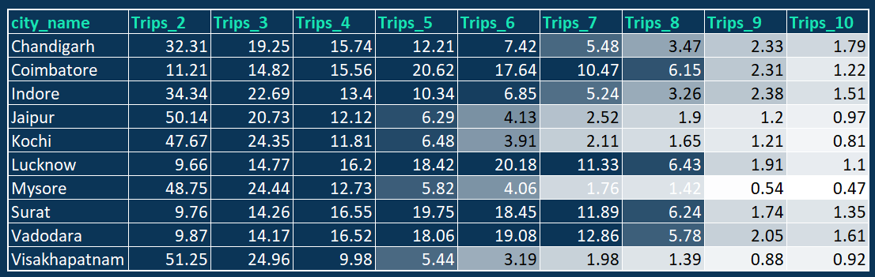
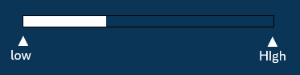
Business Request - 3: City-Level Repeat Passenger Trip Frequency Report
Generate a city-level report showing the percentage distribution of repeat passengers by trip count (2 to 10 trips) to identify cities with high repeat trip frequency, with fields: city_name, 2-Trips, 3-Trips, 4-Trips, 5-Trips, 6-Trips, 7-Trips, 8-Trips, 9-Trips, and 10-Trips.

Slide 16
INSIGHTS & RECOMMENDATIONS
INSIGHTS
RECOMMENDATIONS
Cities with High Repeat Trip Frequency:
Jaipur, Kochi, Mysore, and Visakhapatnam: Over 47% of passengers complete 2 trips, indicating strong short-term retention.
Visakhapatnam has the highest 2-trip percentage (51.25%), suggesting a strong initial engagement with repeat passengers.
Mid-Level Repeat Trips (3–5 Trips):
Lucknow, Surat, and Vadodara: Steady mid-level engagement, with 3–5 trips forming over 50% of total repeat trips.
Indicates consistent customer retention after initial rides.
Long-Term Retention (6–10 Trips):
Lucknow, Coimbatore, Surat, and Vadodara: Higher retention in long-term trip categories (6–10 trips), indicating customer loyalty.
Coimbatore has notable peaks in 5-trip (20.62%) and 6-trip (17.64%) categories.
Low Long-Term Retention:
Jaipur and Mysore: Drop significantly after 5 trips, with less than 2% of passengers reaching 10 trips, highlighting retention challenges.
Focus on Long-Term Retention Strategies:
Design loyalty programs to incentivize passengers completing 5+ trips, especially in Jaipur, Mysore, and Kochi.
Targeted Campaigns for Strong Start Cities:
In cities like Visakhapatnam and Jaipur, capitalize on high early repeat trips by offering personalized deals for passengers completing 2–3 trips.
Mid-Level Engagement Opportunities:
Cities like Lucknow, Surat, and Vadodara exhibit strong 3–5 trip retention. Introduce referral programs or exclusive mid-tier rewards to further enhance engagement.
Data-Driven Personalization:
Analyze passenger feedback and preferences in Coimbatore and Vadodara, where repeat trips are prominent, to replicate best practices in underperforming cities.
Localized Retention Strategies:
Lucknow: Develop long-term engagement campaigns targeting high-frequency passengers (6+ trips), given its higher percentage in these categories.
Jaipur, Mysore, and Kochi: Address drop-off points with improved customer service, pricing strategies, or ride packages.
Leverage Technology:
Use AI-based recommendations to suggest next rides or incentives based on individual trip behavior trends to improve retention.

Slide 17
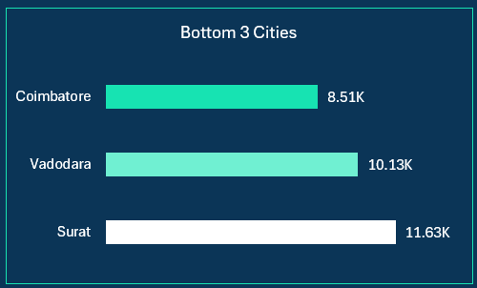
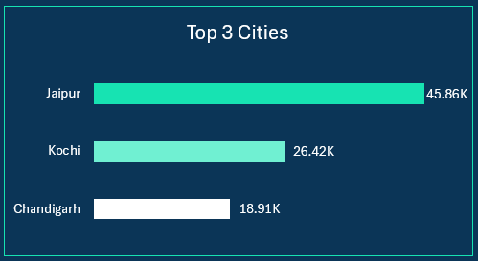
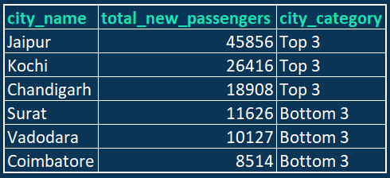
Business Request - 4: Identify Cities with Highest and Lowest Total New Passengers
Generate a report ranking cities by total new passengers, identifying the top 3 cities as "Top 3" and the bottom 3 cities as "Bottom 3," with fields: city_name, total_new_passengers, and city_category.

Slide 18
INSIGHTS & RECOMMENDATIONS
INSIGHTS
Top 3 Cities:
Jaipur, Kochi, and Chandigarh attract the highest number of new passengers, indicating effective acquisition strategies or favorable market conditions.
Jaipur leads with a significant margin, with 45,856 new passengers, suggesting strong demand or successful marketing initiatives.
Bottom 3 Cities:
Surat, Vadodara, and Coimbatore rank the lowest, with Coimbatore having only 8,514 new passengers, pointing to challenges in passenger acquisition.
These cities may face market saturation, weaker promotional efforts, or lower demand for cab services.
Mid-Level Cities:
Cities not categorized in the Top 3 or Bottom 3 (e.g., Lucknow, Mysore, Indore) may require additional analysis to understand their position relative to top and bottom performers.

Slide 19
INSIGHTS & RECOMMENDATIONS
RECOMMENDATIONS
Replicate Success from Top 3 Cities:
Analyze the marketing strategies, customer acquisition channels, and competitive advantages of Jaipur, Kochi, and Chandigarh to implement similar practices in underperforming cities.
Focus on Bottom 3 Cities:
Surat, Vadodara, and Coimbatore:
Marketing Campaigns: Increase visibility through city-specific digital and offline campaigns, emphasizing introductory offers or partnerships with local businesses.
Market Research: Conduct surveys or focus groups to understand barriers to adoption, such as pricing, competition, or customer preferences.
Localized Strategies for Growth:
Surat and Vadodara: Explore partnerships with local businesses and event organizers to drive demand, especially in areas of high footfall.
Coimbatore: Focus on value-based promotions, such as budget-friendly packages or discounts for frequent travelers.
Leverage Top Cities for Branding:
Highlight the success of Jaipur, Kochi, and Chandigarh in branding campaigns to build credibility and attract new passengers across all regions.
Technology and Data Integration:
Utilize analytics to identify untapped customer segments or regions within Bottom 3 Cities where demand can be stimulated.
Track and optimize campaign performance to ensure resources are effectively allocated.
Customer Feedback and Retention:
Engage with passengers in Bottom 3 Cities to gather feedback on service quality and potential improvements.
Focus on retaining new passengers in Top 3 Cities by offering loyalty programs to sustain growth momentum.

Slide 20
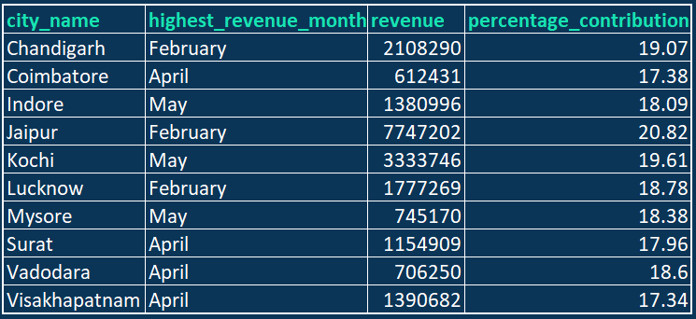
Business Request - 5: Identify Month with Highest Revenue for Each City
Generate a report identifying the month with the highest revenue for each city, displaying the month_name, revenue amount, and its percentage contribution to the city's total revenue, with fields: city_name, highest_revenue_month, revenue, and percentage_contribution.

Slide 21
INSIGHTS & RECOMMENDATIONS
INSIGHTS
RECOMMENDATIONS
Peak Revenue Months by City:
February and April dominate as the highest revenue-generating months across most cities, with May also showing strong performance in specific cities.
Jaipur achieved the highest single-month revenue, generating ₹7,747,202 in February, contributing 20.82% to its total revenue.
Revenue Distribution:
Coimbatore (17.38%) and Visakhapatnam (17.34%) have lower contributions from their peak months, suggesting more distributed revenue generation or market challenges.
Seasonality Trends:
February stands out as a key revenue month, likely influenced by tourism or events such as festivals.
May, a significant contributor in cities like Indore (18.09%) and Kochi (19.61%), may indicate demand driven by summer holidays or local seasonal factors.
Potential for Growth in Underperforming Cities:
Cities with lower peak month contributions, such as Coimbatore and Vadodara, may benefit from strategies to increase demand during other months to balance revenue streams.
Capitalize on Seasonal Trends:
Tourism and Events: Leverage the tourism appeal of cities like Jaipur and Kochi during their high-revenue months with targeted campaigns. Collaborate with tourism boards and event organizers to attract more passengers.
Holiday Campaigns: For cities like Indore and Mysore, run promotional offers during summer vacations or festive seasons to maximize demand.
Diversify Revenue Streams:
For cities like Coimbatore and Visakhapatnam, introduce campaigns in off-peak months to increase overall revenue. Utilize discounts or loyalty rewards to sustain demand during leaner periods.
Strategic Partnerships:
Collaborate with hotels, travel agencies, and event venues in peak revenue months to drive additional trips and enhance customer acquisition.
Focus on High-Performing Cities:
Invest more resources in cities like Jaipur, Kochi, and Chandigarh, which show strong revenue potential. Expand fleet sizes and improve service availability to capitalize on peak demand.
Customer Retention During Peak Months:
Implement loyalty programs or subscription models to retain customers acquired during high-revenue months. This could ensure sustained revenue growth beyond seasonal peaks.

Slide 22
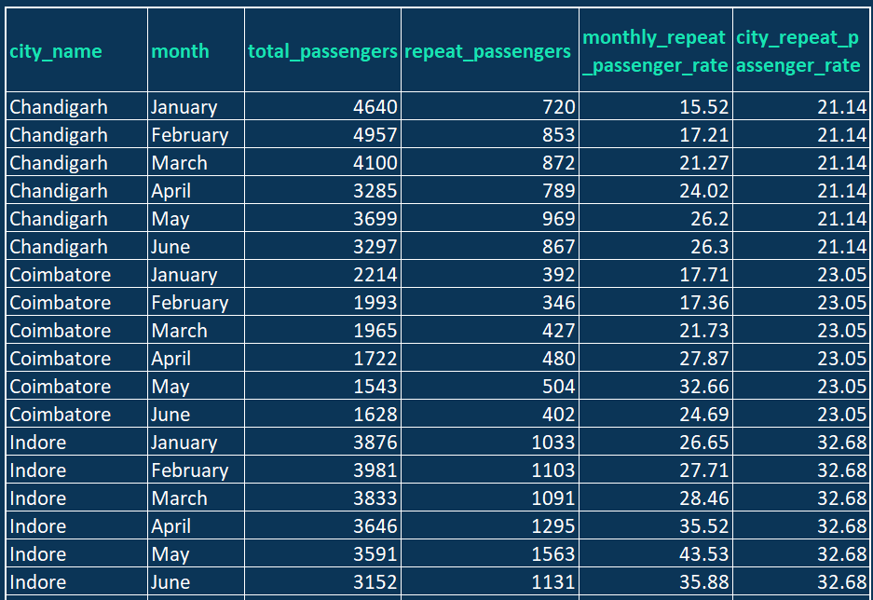
Business Request - 6: Repeat Passenger Rate Analysis
Generate a report calculating the monthly repeat passenger rate (repeat passengers as a percentage of total passengers for each city and month) and the city-wide repeat passenger rate (overall repeat passenger rate aggregated across months), with fields: city_name, month, total_passengers, repeat_passengers, monthly_repeat_passenger_rate (%), and city_repeat_passenger_rate (%).
..more

Slide 23
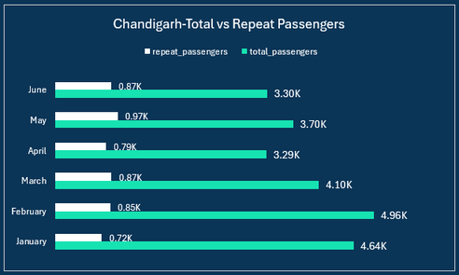
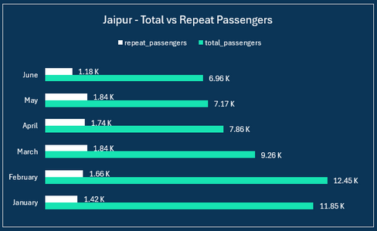
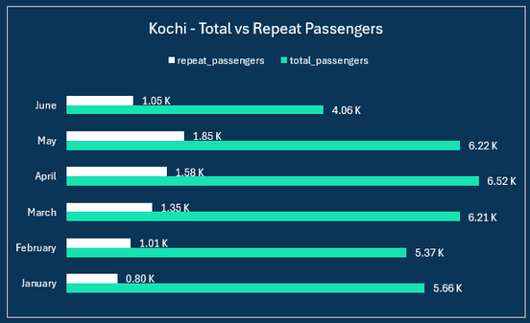
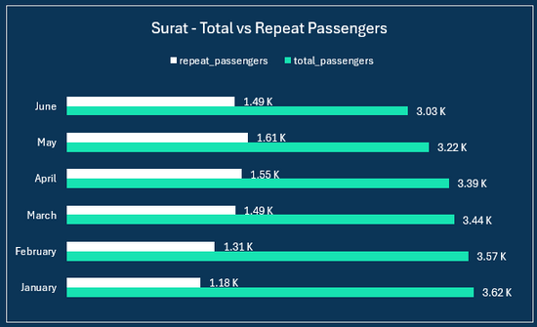
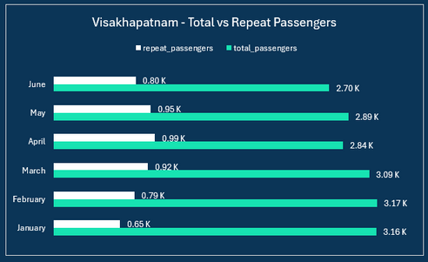
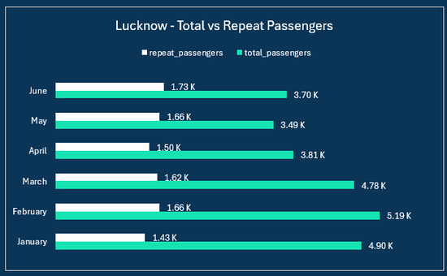
INSIGHTS & RECOMMENDATIONS
INSIGHTS
City-Wide Repeat Passenger Rates:
Surat (42.63%), Lucknow (37.12%), and Indore (32.68%) have the highest city-wide repeat passenger rates, indicating strong customer retention.
Mysore (11.23%) has the lowest repeat passenger rate, suggesting limited passenger loyalty or opportunities for repeat travel.
Monthly Repeat Passenger Trends:
Surat consistently has high monthly repeat passenger rates, peaking in May (49.92%) and June (49.17%).
Lucknow also shows strong performance in May (47.66%) and June (46.7%), likely influenced by effective loyalty programs or seasonal demand.
Mysore and Jaipur have the most room for improvement, with consistently low monthly repeat rates (e.g., Mysore February: 7.99%).

Slide 24
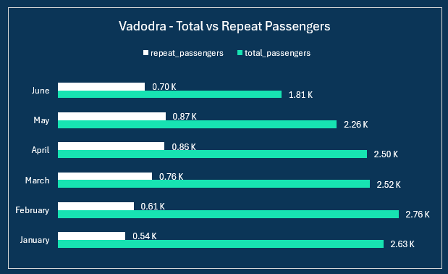
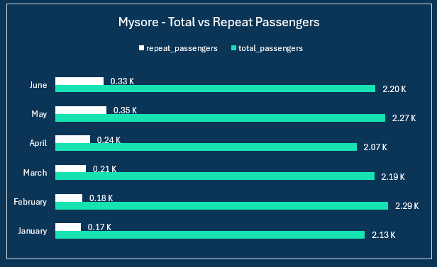
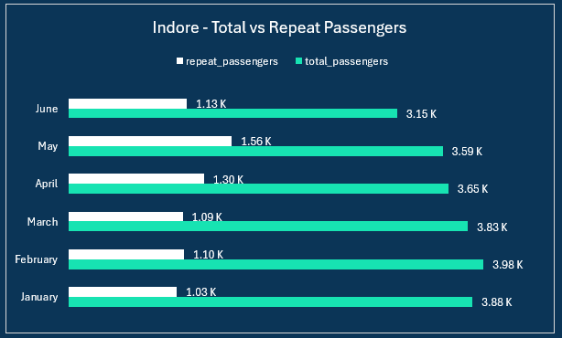
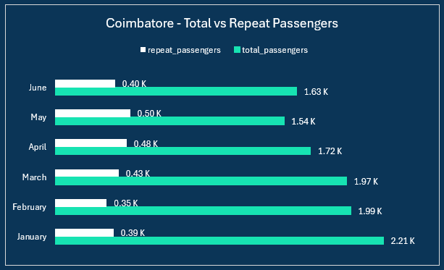
INSIGHTS & RECOMMENDATIONS
INSIGHTS
Regional Variability:
Coastal cities like Kochi (22.4%) and Visakhapatnam (28.61%) have moderate repeat rates, suggesting potential for targeted marketing to convert more first-time travelers into repeat customers.
Northern cities like Jaipur (17.43%) and Chandigarh (21.14%) exhibit lower repeat rates compared to peers.
Impact of Specific Months:
Peak months for repeat passengers are typically summer or post-holiday periods, such as May and June, with rates surging across multiple cities during these months.
Conversely, months like January and February generally show lower repeat rates across many regions.

Slide 25
INSIGHTS & RECOMMENDATIONS
RECOMMENDATIONS
Focus on High-Potential Cities:
Prioritize expanding customer loyalty programs in high-performing cities like Surat, Lucknow, and Indore, leveraging their strong repeat passenger base to increase market share.
Enhance Retention in Low-Performing Cities:
Launch targeted campaigns in cities with low repeat rates, such as Mysore and Jaipur, offering incentives like discounted fares, referral bonuses, or exclusive membership benefits for frequent travelers.
Seasonal Promotions:
Boost marketing during high-repeat months like May and June across all cities to capitalize on existing trends and encourage repeat travel through special offers.
Data-Driven Personalization:
Use passenger data to personalize promotions and communication. For instance, passengers with one trip in Chandigarh or Kochi can be offered tailored discounts for their next trip to nudge repeat behavior.
Improve Accessibility and Service Quality:
Enhance service quality and accessibility in low-repeat cities, particularly Mysore and Jaipur, to attract more repeat passengers. Offering improved travel experiences can lead to increased loyalty.
Monitor and Adjust Strategies:
Regularly analyze monthly repeat passenger rates to identify shifts in trends or impacts of interventions. Use these insights to refine city-specific strategies and allocate resources effectively.

Slide 26
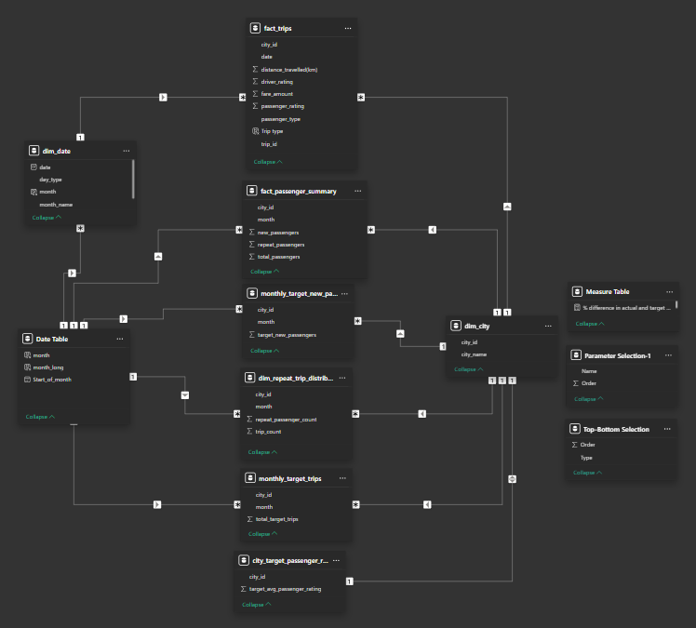

07
DATA MODEL
The data model is designed using a combination of Star and Snowflake Schemas, ensuring efficient data organization and query performance. Centralized fact tables are connected to dimension tables for enhanced analytical capabilities.
Data Exploration: Initial data exploration was conducted using MySQL to identify patterns, detect anomalies, and understand relationships across tables.
Data Cleaning & Transformation: Data was cleaned and transformed using Power Query, ensuring data integrity, accuracy, and readiness for analysis. This step involved handling missing values, standardizing formats, and resolving inconsistencies.
Table Relationships: Relationships between tables and derived tables were established based on analytical requirements. These relationships support dynamic querying and streamlined data visualization.
Dashboard

Slide 27
08
PRIMARY AND SECONDARY ANALYSIS

Slide 28
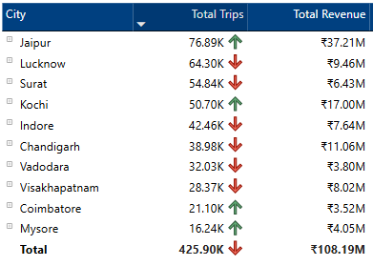
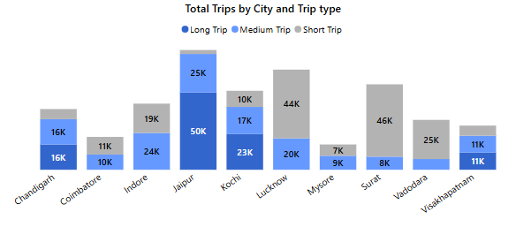
08
DASHBOARD INSIGHTS
Top and Bottom Performing Cities by total trips
Top Performing Cities:
Jaipur (77K trips, ₹37.21M revenue):
High trip volume and revenue highlight its status as a tourism hub, with demand driven by seasonal travelers and events.
Strong performance suggests successful market penetration and alignment with passenger needs.
Lucknow (64K trips, ₹9.46M revenue):
Moderate revenue despite high trips indicates the dominance of shorter or medium, low-fare rides, likely influenced by local commute needs.
A mixed demand base of administrative travel, local commuters, and limited tourism activity.
Surat (55K trips, ₹6.43M revenue):
Consistent business travel likely drives trip volume. Lower revenue suggests shorter or medium ride distances or competitive pricing strategies to attract customers.

Slide 29
08
DASHBOARD INSIGHTS
Top and Bottom Performing Cities by total trips
Bottom Performing Cities:
Visakhapatnam (28K trips, ₹8.02M revenue):
Despite low trip volume, revenue is relatively high, possibly due to longer-distance trips or higher fare rates from tourism demand.
Operational inefficiencies or limited service reach may be restricting trip volume.
Coimbatore (21K trips, ₹3.52M revenue):
Low trip volume and revenue suggest limited demand or reliance on alternative transportation modes like buses or autos.
Opportunities exist in targeting the growing tech sector and student populations.

Slide 30
08
DASHBOARD INSIGHTS
Top and Bottom Performing Cities by total trips
Bottom Performing Cities:
3. Mysore (16K trips, ₹4.05M revenue):
Despite being a tourism-centric city, trip volume and revenue are the lowest, indicating gaps in marketing, service availability, or local partnerships.
Potential for growth in tourism-driven demand during peak seasons.

Slide 31
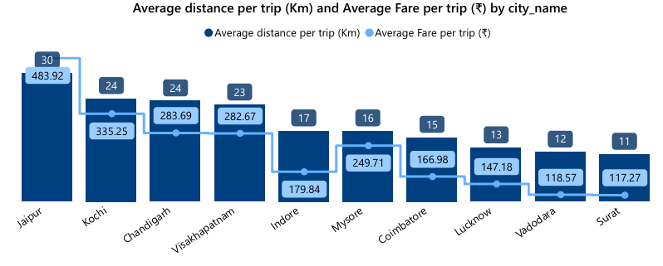
08
DASHBOARD INSIGHTS
Average Fare and distance per Trip by City
Jaipur (30 km, ₹483.92):
High average distance and fare indicate strong intercity and tourism demand. Long trips contribute significantly to revenue.
As a top-performing city in terms of revenue and trip count, its pricing and service model are well-aligned with passenger needs.
Kochi & Chandigarh (24 km, ~₹300):
Moderate distances with relatively higher fares suggest potential for tourism-driven demand and mid-range business travel.
Focused marketing campaigns in tourist seasons could further enhance demand.

Slide 32
08
DASHBOARD INSIGHTS
Average Fare and distance per Trip by City
3.Visakhapatnam (23 km, ₹282.67):
Comparable to Kochi and Chandigarh in trip characteristics, indicating similar tourism-centric demand. However, trip volume is low, highlighting potential service reach or marketing gaps.
4.Lucknow, Vadodara, Surat (11–13 km, ~₹120–₹150):
Low average distances and fares suggest strong demand for short, intra-city commutes.
These cities likely cater to local residents and business commuters rather than tourists.
5.Coimbatore & Mysore (15–16 km, ~₹160–₹250):
Slightly higher fares compared to Lucknow but lower demand overall. Mysore’s tourism potential isn't fully realized, while Coimbatore’s demand may be constrained by competition or limited service availability.

Slide 33
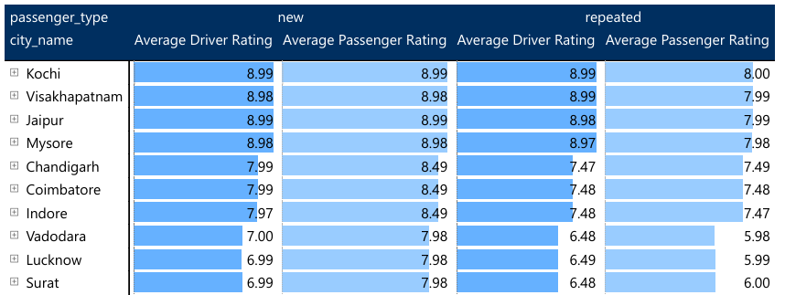
08
DASHBOARD INSIGHTS
Average Ratings by City and Passenger Type
Top Cities for Consistent Ratings (Kochi, Vishakhapatnam, Jaipur, Mysore):
New Passengers: Kochi, Jaipur, Mysore, and Vishakhapatnam achieve excellent driver and passenger ratings (8.98–8.99), suggesting high service satisfaction and consistent performance.
Repeat Passengers: These cities show slightly lower passenger ratings (~7.98–8.00), hinting at a need for service enhancement for loyal users to maintain satisfaction.
Moderate Performance Cities (Chandigarh, Coimbatore, Indore):
Driver ratings for repeat passengers (7.47–7.48) drop compared to new passengers (~7.99), indicating challenges in maintaining consistent service quality.
Passenger ratings are stable (~7.48–8.49), showing room for improvement to enhance loyalty.

Slide 34
08
DASHBOARD INSIGHTS
Average Ratings by City and Passenger Type
3.Low-Performing Cities (Vadodara, Lucknow, Surat):
Vadodara, Lucknow, and Surat show the lowest ratings for repeat passengers, with:
Driver Ratings: ~6.48–6.49.
Passenger Ratings: ~5.98–6.00.
These figures highlight dissatisfaction among returning passengers, potentially due to inconsistent service quality, pricing concerns, or operational inefficiencies.

Slide 35
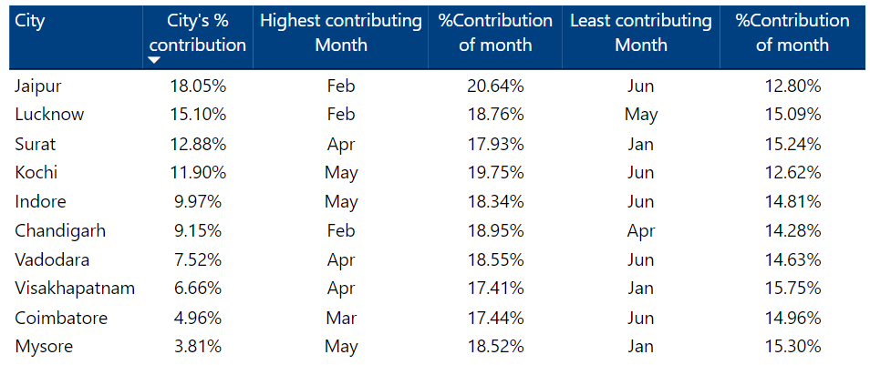
08
DASHBOARD INSIGHTS
Peak and Low Demand Months by City by total trips
Seasonal Peaks and Lows:
Top Contributing Months:
February is a peak month for Jaipur, Lucknow, and Chandigarh, indicating increased travel demand post-winter.
April-May sees high demand in Surat, Kochi, Indore, Vadodara, and Mysore, aligning with summer holidays and pre-monsoon tourism.
March is significant for Coimbatore, showing a steady increase before seasonal lows.

Slide 36
08
DASHBOARD INSIGHTS
Peak and Low Demand Months by City by total trips
Low Demand Periods:
June consistently shows low demand across most cities (Jaipur, Kochi, Indore, Vadodara, Coimbatore) due to the monsoon season.
January sees a dip in Surat, Mysore, and Visakhapatnam, possibly due to post-holiday travel slowdowns.
May is the least contributing month for Lucknow, indicating city-specific dynamics during peak summer.

Slide 37
08
DASHBOARD INSIGHTS
Peak and Low Demand Months by City by total trips
2.City-Level Contribution Patterns:
Jaipur, Lucknow, and Surat contribute the most (18.05%, 15.10%, 12.88%) to total trips, emphasizing their importance for overall business performance.
Mysore (3.81%) and Coimbatore (4.96%) are the smallest contributors, indicating untapped potential or lower demand patterns.

Slide 38
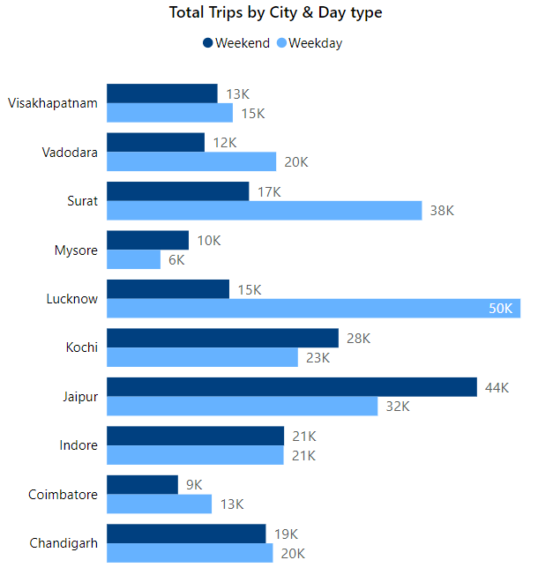
08
DASHBOARD INSIGHTS
Weekend vs. Weekday Trip Demand by City
Insights:
Higher Weekend Demand (Tourism):
Jaipur (44K), Kochi (28K), Mysore (10K): Driven by leisure and tourism travel.
Higher Weekday Demand (Business):
Lucknow (50K), Surat (38K), Vadodara (20K): Dominated by business commuters.
Balanced Demand:
Indore and Chandigarh show steady usage across both weekdays and weekends.
Low Weekend Demand:
Coimbatore and Visakhapatnam: Slight preference for weekdays, indicating work-driven trips.

Slide 39
08
DASHBOARD INSIGHTS
Weekend vs. Weekday Trip Demand by City
Recommendations:
Optimize Fleet Allocation:
Increase weekend fleet in Jaipur, Kochi, Mysore.
Focus on weekdays for Lucknow, Surat, Vadodara.
Targeted Marketing Campaigns:
Tourism Cities: Promote weekend offers, family packages, and partnerships with hotels/events.
Business Cities: Introduce corporate ride packages and weekday subscriptions.
Leverage Balanced Cities:
Test dynamic pricing in Indore and Chandigarh to boost both segments.
Stimulate Weekend Demand in Low Cities:
Launch weekend discounts and tie-ups in Coimbatore and Visakhapatnam.

Slide 40
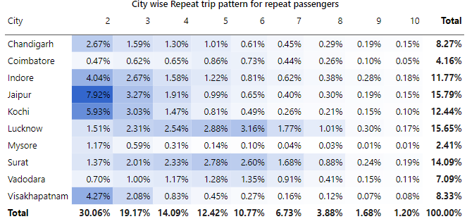
08
DASHBOARD INSIGHTS
Repeat Passenger Frequency and City Contribution Analysis
Top Performing Cities for Repeat Trips:
Jaipur (15.79%) and Lucknow (15.65%) lead in repeat passenger trips, particularly for 2-trip and higher frequencies.
These cities have strong repeat usage, indicating high passenger satisfaction, loyalty, and demand.
2. Least Performing City:
Mysore (2.41%) shows the lowest repeat passenger contributions across all trip counts. Low engagement may indicate weaker service satisfaction or limited demand.

Slide 41
08
DASHBOARD INSIGHTS
Repeat Passenger Frequency and City Contribution Analysis
3.Trip Patterns by City Type:
Tourism-centric Cities: Jaipur, and Kochi display higher repeat frequencies for shorter trips (2-3 trips), aligning with seasonal leisure travel and quick trip turnover.
Business-centric Cities: Lucknow and Surat contribute significantly to higher frequencies (4-7 trips), showing reliance on cab services for regular commuting.

Slide 42
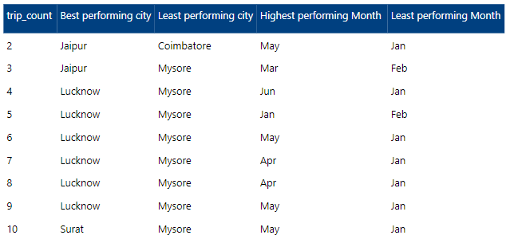
08
DASHBOARD INSIGHTS
Repeat Passenger Frequency and City Contribution Analysis
4.City-Specific Highlights:
Jaipur: Highest for 2-trip (7.92%) passengers; strong retention and seasonal demand in May.
Lucknow: Highest contribution in repeat trips (2-7 trips), indicating heavy reliance for daily business mobility.
Surat: Consistent performance across mid-range trip counts (4-7trips).
Mysore & Coimbatore: Weak engagement across all frequencies; potential for targeted marketing and service improvement.

Slide 43
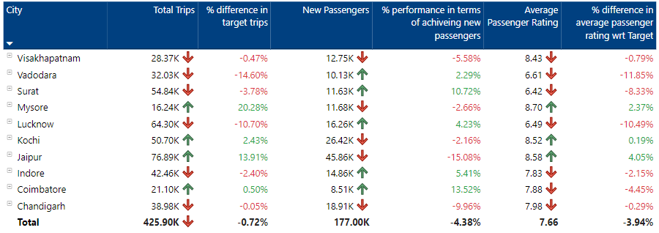
08
DASHBOARD INSIGHTS
Monthly Target Achievement Analysis for Key Metrics
Total Trips Target Performance:
Overachievers:
Mysore (+20.28%) and Jaipur (+13.91%) significantly exceeded their targets, showing strong demand.
Kochi (+2.43%) and Coimbatore (+0.50%) also met their trip targets.
Underperformers:
Vadodara (-14.60%), Lucknow (-10.70%), and Surat (-3.78%) fell short of their total trip targets.

Slide 44
08
DASHBOARD INSIGHTS
Monthly Target Achievement Analysis for Key Metrics
2 .New Passenger Acquisition:
High Performers:
Surat (+10.72%), Coimbatore (+13.52%), and Indore (+5.41%) achieved or exceeded their new passenger targets, suggesting effective marketing or organic growth.
Underperformers:
Jaipur (-15.08%) and Visakhapatnam (-5.58%) show significant shortfalls, indicating a need to boost passenger acquisition efforts.

Slide 45
08
DASHBOARD INSIGHTS
Monthly Target Achievement Analysis for Key Metrics
3. Average Passenger Rating Performance:
Top Cities:
Jaipur (+4.05%) and Mysore (+2.37%) exceeded their target ratings, reflecting high customer satisfaction.
Kochi (+0.19%) met expectations.
Struggling Cities:
Vadodara (-11.85%), Lucknow (-10.49%), and Surat (-8.33%) fell far below target ratings, signaling customer dissatisfaction.

Slide 46
08
DASHBOARD INSIGHTS
Monthly Target Achievement Analysis for Key Metrics
4.Tourism vs. Business-Centric Trends:
Tourism-Centric Cities (e.g., Jaipur, Kochi, Mysore):
Strong performance in total trips and passenger ratings, particularly in Jaipur and Mysore, indicating seasonal tourism demand.
Business-Centric Cities (e.g., Vadodara, Surat, Lucknow):
Struggled with achieving targets for passenger ratings and total trips, suggesting challenges in maintaining service quality or meeting consistent demand.

Slide 47
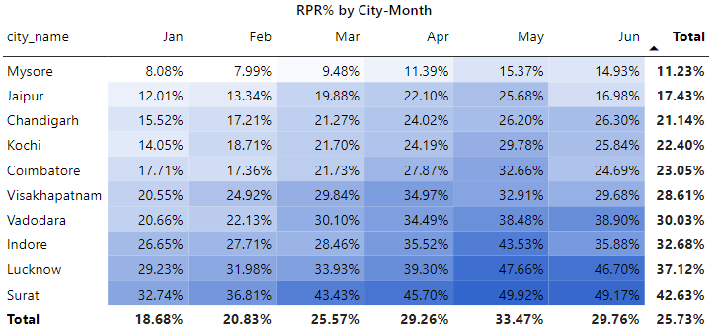
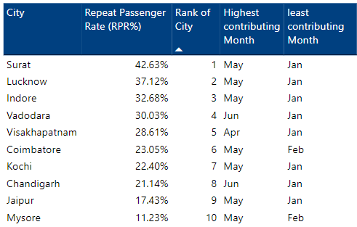
08
DASHBOARD INSIGHTS
Highest and Lowest Repeat Passenger Rate (RPR%) by City and Month
Top & Bottom Cities by RPR%:
Top 2 Cities:
Surat (42.63%): Highest repeat passenger rate, with May as the peak month.
Lucknow (37.12%): Strong RPR, also peaking in May.
Bottom 2 Cities:
Jaipur (17.43%): Low repeat passenger rate, despite a peak in May.
Mysore (11.23%): Lowest repeat rate, with a slight peak in May but overall underperformance.
RPR% by Month:
Highest RPR Month: May saw the highest RPR at 33.47%, suggesting strong repeat engagement, possibly driven by tourism or seasonal demand.
Lowest RPR Month: January, with the lowest RPR at 18.68%, indicating a post-holiday decline in repeat passengers.

Slide 48
08
DASHBOARD INSIGHTS
Highest and Lowest Repeat Passenger Rate (RPR%) by City and Month
3.City Trends:
High RPR Cities: Surat, Lucknow, Indore, and Vadodara consistently performed well, with peaks in May–June.
Low RPR Cities: Mysore and Jaipur showed weaker repeat passenger engagement, possibly indicating a reliance on first-time or seasonal passengers.

Slide 49
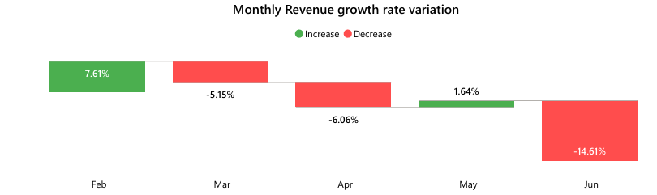

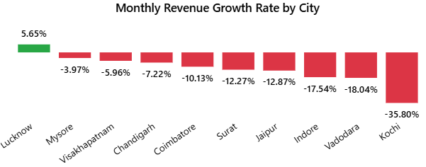

08
DASHBOARD INSIGHTS
REVENUE
Monthly Revenue Growth:
February registered the highest growth, but subsequent months (March, April) saw a decline.
June witnessed a sharp drop in revenue (-14%), except for Lucknow, which maintained growth.

Slide 50
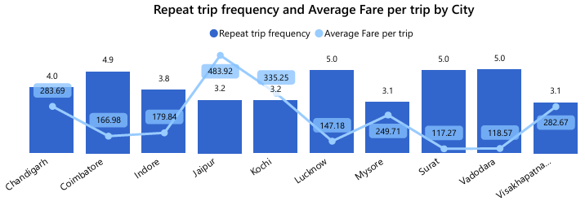
08
DASHBOARD INSIGHTS
TRIPS
Repeat Passenger Insights:
Cities like Surat and Lucknow have higher repeat frequencies (5 trips), but fares remain low (~₹120-150).
Jaipur and Kochi exhibit lower repeat frequencies (3 trips) with higher average fares (~₹250+).

Slide 51
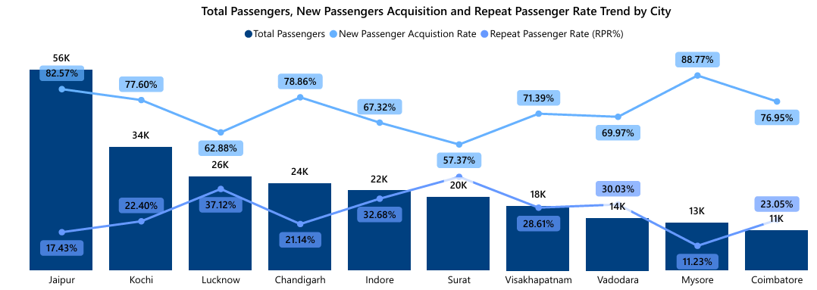
08
DASHBOARD INSIGHTS
PASSENGERS
City-Level Insights:
Jaipur has the highest passenger, while Coimbatore is the least-performing.
New passenger acquisition exceeds retention across all cities.

Slide 52
09
RECOMMENDATIONS
Optimized Fleet and Resource Allocation Strategy
Focus Areas:
Seasonal Demand Management:
Increase fleet availability and optimize resources during peak months (e.g., February, April-May for cities like Jaipur, Lucknow, Surat, Kochi, and Indore) to ensure sufficient capacity to meet high demand, especially in tourism-heavy and business-centric cities.
In low-demand months (e.g., June, January), reduce operational costs by temporarily scaling down fleet availability, leveraging dynamic pricing, and introducing promotional offers to stimulate demand.
Weekend vs. Weekday Focus:
Tourism Cities (Jaipur, Kochi, Mysore): Prioritize fleet availability during weekends to accommodate leisure travelers. Offer weekend promotions or family packages to increase trip volume.
Business-Centric Cities (Lucknow, Surat, Vadodara): Ensure higher fleet availability during weekdays, specifically targeting corporate travelers and office-goers. Subscription or loyalty models can be introduced to retain regular commuters.
Balanced Cities (Indore, Chandigarh): Implement a flexible approach with dynamic pricing strategies to cater to both weekday and weekend demands.

Slide 53
09
RECOMMENDATIONS
Targeted Marketing and Customer Engagement
Focus Areas:
City-Specific Campaigns:
Tourism-Centric Cities (Jaipur, Kochi, Mysore): Focus on holiday packages, local event tie-ups, and special seasonal offers to engage repeat customers. Leverage local hotel and tourism partnerships to attract both first-time and repeat customers during peak travel seasons.
Business Cities (Lucknow, Surat): Promote corporate ride packages, office commutes, and loyalty programs to encourage repeat usage from frequent business travelers.
Low Weekend Demand Cities (Coimbatore, Visakhapatnam): Run targeted campaigns for weekend getaways, with special offers like discounts, event partnerships, or group deals to attract more passengers during off-peak weekends.
Repeat Passenger Engagement:
Mysore & Coimbatore: Implement loyalty programs, referral bonuses, or special offers to encourage repeat business. Focus on increasing repeat passenger rates (RPR) through personalized offers and better service quality.
Jaipur & Lucknow: Offer additional rewards or premium services for high-frequency riders, ensuring they continue to engage with the service regularly. Target RPR peaks in May by offering loyalty rewards or seasonal promotions.
All Cities: Focus on post-trip customer satisfaction surveys to improve service quality and to gather insights into passengers’ preferences and areas of improvement.

Slide 54
09
RECOMMENDATIONS
Pricing and Revenue Maximization Strategies
Focus Areas:
Dynamic Pricing:
Implement surge pricing in peak demand months like February, April-May to maximize revenue from tourism and business travelers. Use dynamic pricing during weekends in cities with heavy tourist traffic and adjust during slower weekdays.
Offer off-peak discounts or incentives in low-demand months (June, January) to maintain resource utilization and minimize fleet idleness.
Corporate and Subscription Packages:
Introduce subscription-based pricing models targeting regular commuters, especially in business-heavy cities like Lucknow, Surat, and Vadodara. Offer bulk travel packages or discounted corporate rides to ensure consistent weekday demand.

Slide 55
09
RECOMMENDATIONS
Customer Satisfaction and Ratings Improvement
Focus Areas:
Service Quality Enhancement:
To improve passenger ratings, particularly in cities like Vadodara, Lucknow, and Surat, invest in driver training programs, improve vehicle conditions, and ensure prompt service to address customer dissatisfaction.
Maintain high standards in tourism-heavy cities like Jaipur and Kochi, focusing on offering superior service and customer experience to ensure repeat passengers and positive ratings.
Surveys and Feedback: Implement a data-driven feedback mechanism to understand passengers' concerns, improving satisfaction in underperforming cities.

Slide 56
09
RECOMMENDATIONS
Repeat Passenger Rate (RPR%) Strategy
Focus Areas:
Increase Repeat Passenger Rate in Low-Performing Cities:
Focus on Mysore and Jaipur, where repeat engagement is low. Leverage loyalty programs, targeted discounts, and personalized services to drive higher RPR.
Capitalize on Peak Repeat Passenger Periods (May):
Surat and Lucknow show peak RPR% in May, and Goodcabs should run seasonal promotions or rewards during this time to maximize repeat business.

Slide 57
09
RECOMMENDATIONS
Factors Influencing Repeat Passenger Rates (RPR)
Insights:
Quality of Service: Cities with higher repeat passenger rates (e.g., Surat, Lucknow) indicate that service quality plays a significant role in fostering loyalty. Passengers in these cities may be more likely to return if they perceive the service as reliable and high-quality.
Competitive Pricing: In cities with lower RPR (e.g., Mysore, Jaipur), pricing might be a factor. Offering competitive pricing, particularly for repeat customers, can increase RPR.
City Demographics: Business-centric cities (Lucknow, Surat) often have higher repeat rates due to regular commuters, while tourism-heavy cities (Jaipur, Kochi) may see seasonal peaks but lower repeat engagement.
Recommendations:
Target quality of service improvements in cities with lower RPR, while integrating pricing strategies (e.g., bulk discounts, loyalty rewards) to improve engagement.

Slide 58
09
RECOMMENDATIONS
Tourism vs. Business Demand Impact
Insights:
Tourism Demand: Jaipur, Kochi, Mysore show strong demand during peak tourism seasons. Local festivals, cultural events, and peak holiday months directly influence trip volume.
Business Demand: Lucknow, Surat, Vadodara exhibit high weekday demand due to commuting and business travel.
Recommendations:
Tailor marketing efforts for tourism cities around local festivals, long weekends, and peak seasons to increase trip volume.
In business cities, focus on corporate partnerships and weekday commuter packages to ensure consistent trip volume throughout the year.

Slide 59
09
RECOMMENDATIONS
Emerging Mobility Trends and Goodcabs' Adaptation
Insights:
The rise of electric vehicles (EVs) and eco-friendly mobility initiatives is gaining momentum in tier-2 cities. There is increasing awareness about sustainability, especially among environmentally-conscious commuters.
Recommendations:
Integrate Electric Vehicles (EVs) into Goodcabs' fleet, especially in cities with growing environmental awareness or where government incentives exist.
Promote green energy solutions and advertise the transition to electric vehicles to attract eco-conscious customers.

Slide 60
09
RECOMMENDATIONS
Partnership Opportunities with Local Businesses
Insights:
Goodcabs can partner with local businesses, such as hotels, malls, and event venues, to increase passenger traffic, especially during peak tourism or local events.
Recommendations:
Collaborate with tourist spots, event venues, or hotels to offer exclusive discounts or ride packages for tourists in cities like Jaipur and Kochi.
Corporate tie-ups with businesses in Lucknow and Surat can boost weekday demand and improve loyalty through exclusive commuter deals.

Slide 61
09
RECOMMENDATIONS
Data Collection for Enhanced Data-Driven Decisions
Insights:
Collecting deeper insights into customer behavior, such as trip frequency, time of booking, and travel preferences, can provide valuable data to optimize fleet allocation and marketing strategies.
Recommendations:
Collect data on passenger demographics, ride frequency, and feedback to better understand customer patterns and preferences.
Implement advanced predictive analytics for better demand forecasting and resource allocation, particularly during peak seasons or for repeat customer engagement.

Slide 62
10
CONCLUSION
By aligning strategies with demand fluctuations, seasonal trends, and improving repeat passenger engagement, Goodcabs can enhance its operational efficiency, revenue, customer satisfaction, and loyalty across cities. Key focus areas should include optimized fleet management, dynamic pricing, customer loyalty programs, and targeted marketing campaigns. Addressing emerging trends like electric vehicles, tourism impacts, and corporate partnerships will further enhance Goodcabs’ competitive edge in both tourism and business-centric cities.

Slide 63


THANK YOU
SHELLY NAGAR
shellynagar75@gmail.com
https://www.linkedin.com/in/shellynagar/
https://github.com/shellynagar27
https://codebasics.io/portfolio/Shelly-Nagar

